Slide 1


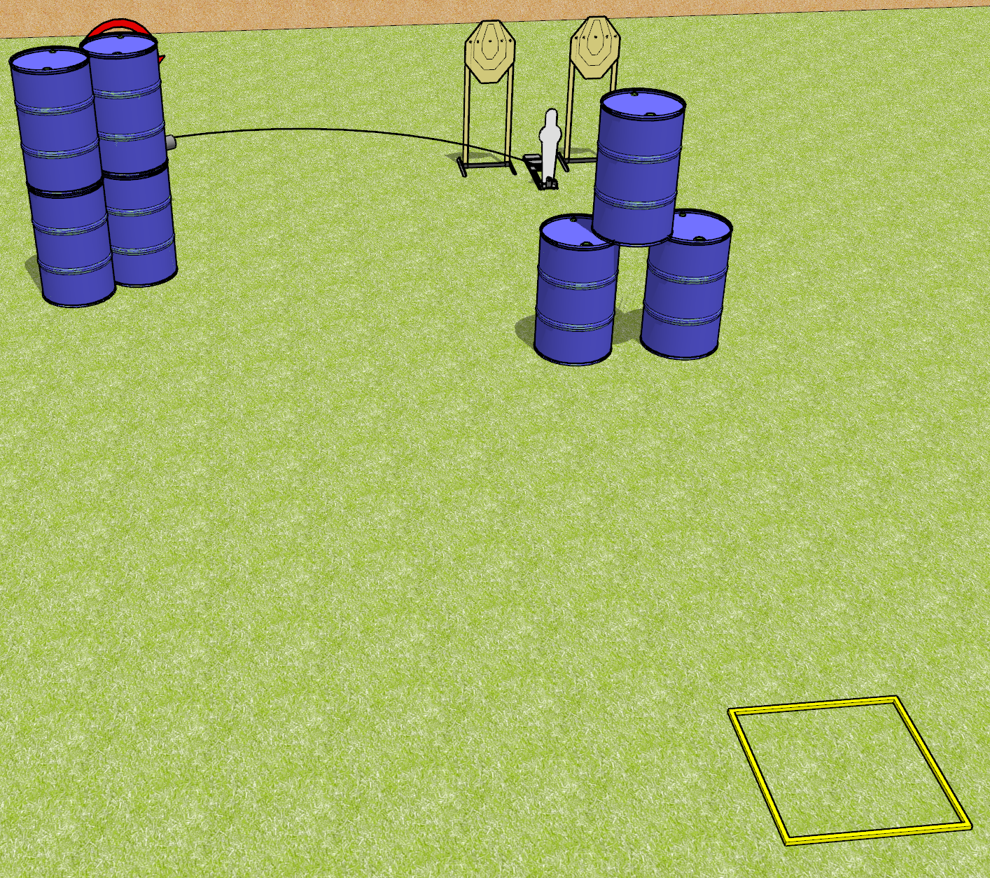
 | Dothan Gun Club – USPSA Match Down in Back Course Designer : Drew Coleman
Round Count 11 rounds 3 IPSC 1 Mini popper
Equipment List 1 swinger + activator 1 shooting box

Slide 2
Down in Back
Written Stage Briefing
Down in Back is an 11 round, 55 point, Comstock speed shoot. There are 3 IPSC targets and 1 steel . The best 2 hits on the static paper will score, and best 6 hits on the swinger will score. Steel must fall to score.
The swinger is activated by the mini popper and is visible at rest. Please check the activator prior to walkthrough and set it the same way every time.
Handgun start position is in shooting box, wrists above shoulders. Handgun is loaded and holstered.
PCC start position is in shooting box, stock on belt. Loaded carbine is held with both hands, safety on.
The static paper and the mini popper are one array. The static paper require 2 hits each.
The swinger is another array, and requires 6 hits.
On start signal, engage 1 array, perform a mandatory reload, and engage the remaining array. You must perform a reload when changing between arrays.

Slide 3
 | Dothan Gun Club – USPSA Match Down in Back Course Designer : Drew Coleman
Round Count 11 rounds 3 IPSC 1 Mini popper
Equipment List 1 swinger + activator 1 shooting box

Slide 4
Down in Back
Written Stage Briefing
Down in Back is an 11 round, 55 point, Comstock speed shoot. There are 3 IPSC targets and 1 steel . The best 2 hits on the static paper will score, and best 6 hits on the swinger will score. Steel must fall to score.
The swinger is activated by the mini popper and is visible at rest. Please check the activator prior to walkthrough and set it the same way every time.
Handgun start position is in shooting box, wrists above shoulders. Handgun is loaded and holstered.
PCC start position is in shooting box, stock on belt. Loaded carbine is held with both hands, safety on.
On start signal, engage either the static paper with 2 hits each, or the swinger with 6 hits, reload, and engage the remaining array. You must perform a reload when switching between paper arrays. Steel may be engaged at any time.

Slide 5
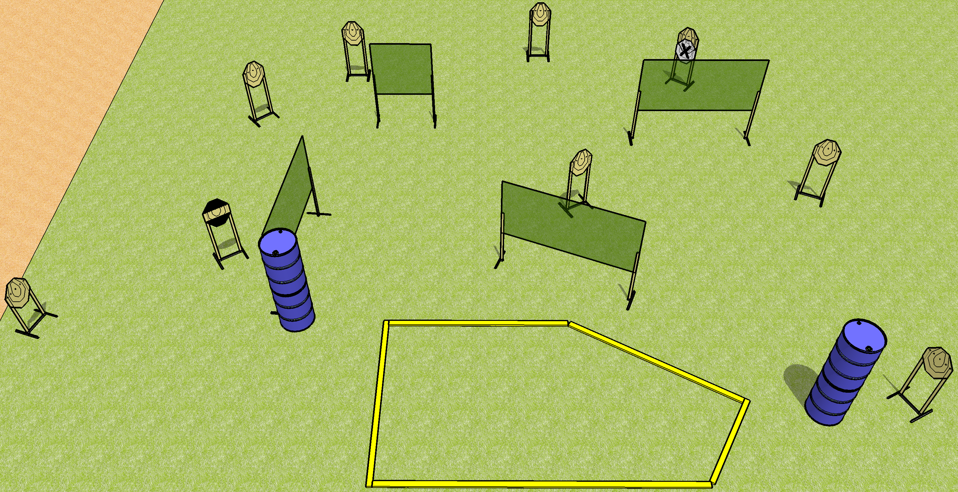
 | Dothan Gun Club – USPSA Match Off Like a Herd of Turtles Course Designer : Drew Coleman
Round Count 18 rounds 9 IPSC
Equipment List 8 wall feet 1 medium fault line 1 striped HC

Slide 6
Off Like a Herd of Turtles
Written Stage Briefing
Off Like a Herd of Turtles is an 18 round, 90 point, Comstock course of fire. There are 9 IPSC targets. The best 2 hits on paper will score. The start signal is audible.
Handgun start position is anywhere inside the shooting area, wrists below belt. Handgun is loaded and holstered.
PCC start position is anywhere inside the shooting area, stock on belt. Carbine is loaded, safety on.
On start signal, engage targets as they become available from within the shooting area.

Slide 7
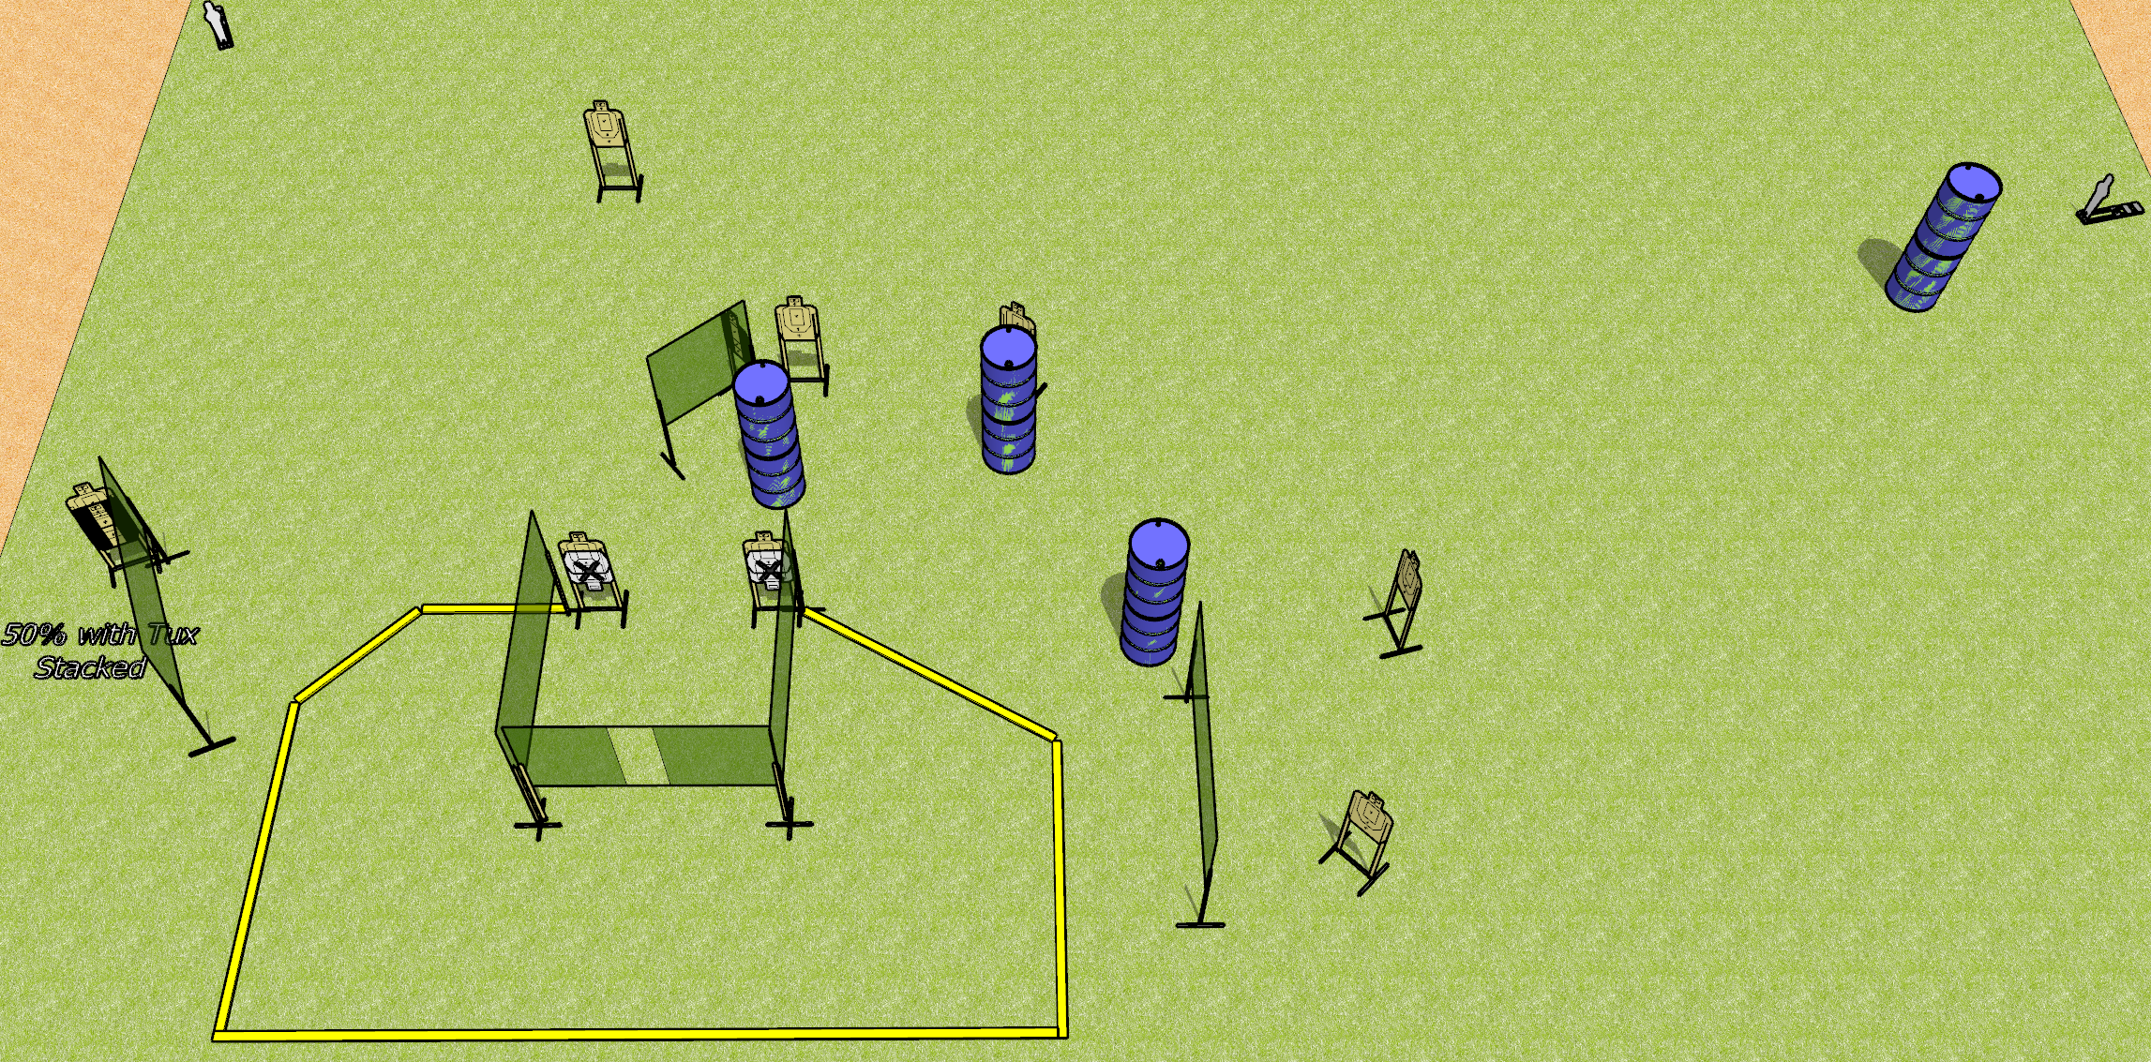
 | Dothan Gun Club – USPSA Match Vengeance Course Designer : Drew Coleman
Round Count 22 rounds 10 USPSA 2 mini poppers
Equipment List 10 wall feet 2-3 medium fault lines 2 Tuxedos, 1 50%

Slide 8
Vengeance
Written Stage Briefing
Vengeance is a 22 round, 110 point, Comstock course of fire. There are 10 USPSA targets and 2 mini poppers. The best 2 hits on paper will score, and steel must fall to score. The start signal is audible.
Handgun start position is toes touching rear fault line, facing uprange, wrists above shoulders. Handgun is loaded and holstered.
PCC start position is heels touching rear fault line, stock on belt. Carbine is loaded, safety on.
On start signal, engage targets as they become available from within the shooting area.

Slide 9
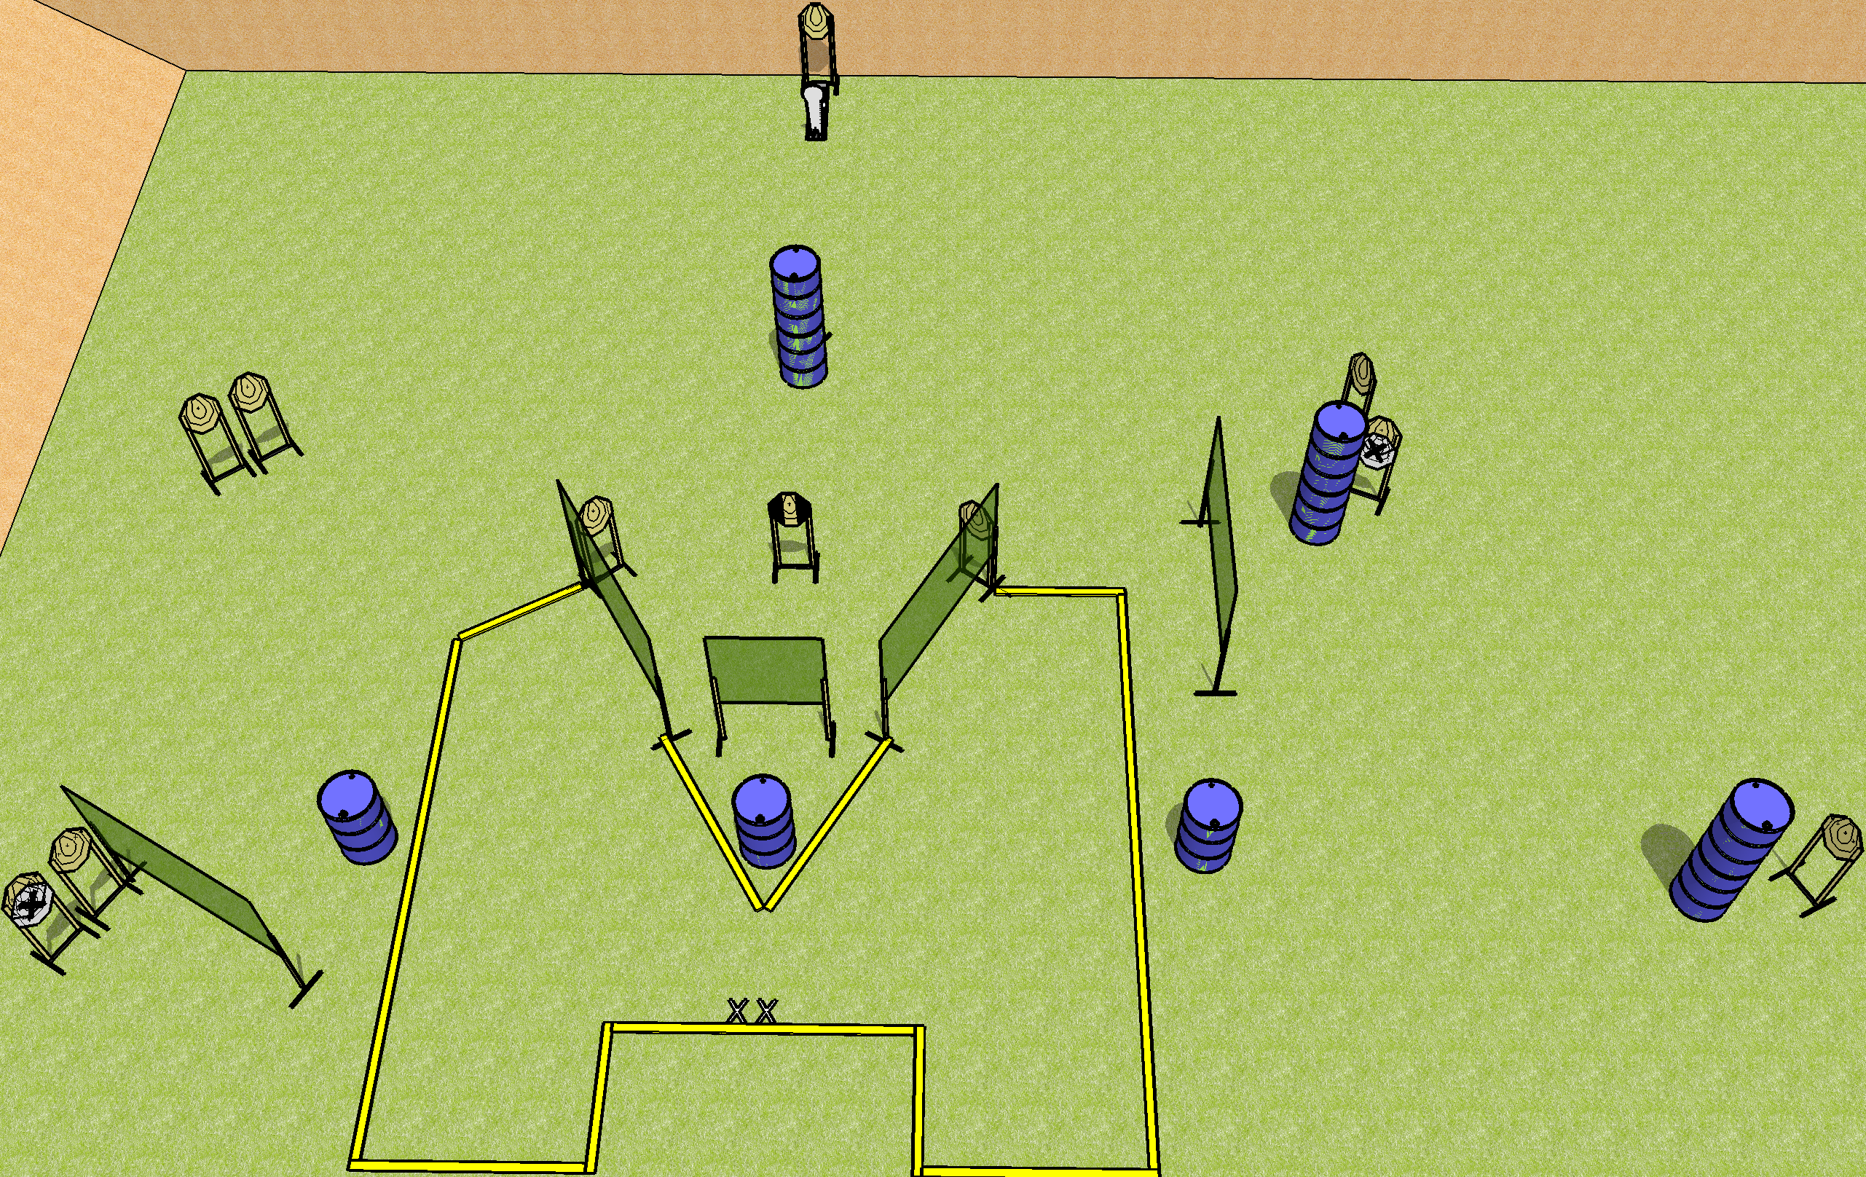
 | Dothan Gun Club – USPSA Match Funny Looking Course Designer : Drew Coleman
Round Count 25 rounds 12 IPSC 1 colt popper
Equipment List 10 wall feet 6 medium fault lines and 1 8’ fault line for the center near the X’s 1 tuxedo, 1 half

Slide 10
Funny Looking
Written Stage Briefing
Funny Looking is a 25 round, 125 point, Comstock course of fire. There are 12 IPSC targets and 1 Colt popper. The best 2 hits on paper will score, and steel must fall to score. The start signal is audible.
Handgun start position is heels on X’s, wrists below belt. Handgun is UNLOADED and holstered.
PCC start position is heels on X’s, stock on belt. Carbine is UNLOADED.
All magazines to be used on stage must start on barrels.
On start signal, engage targets as they become available from within the shooting area.

Slide 11
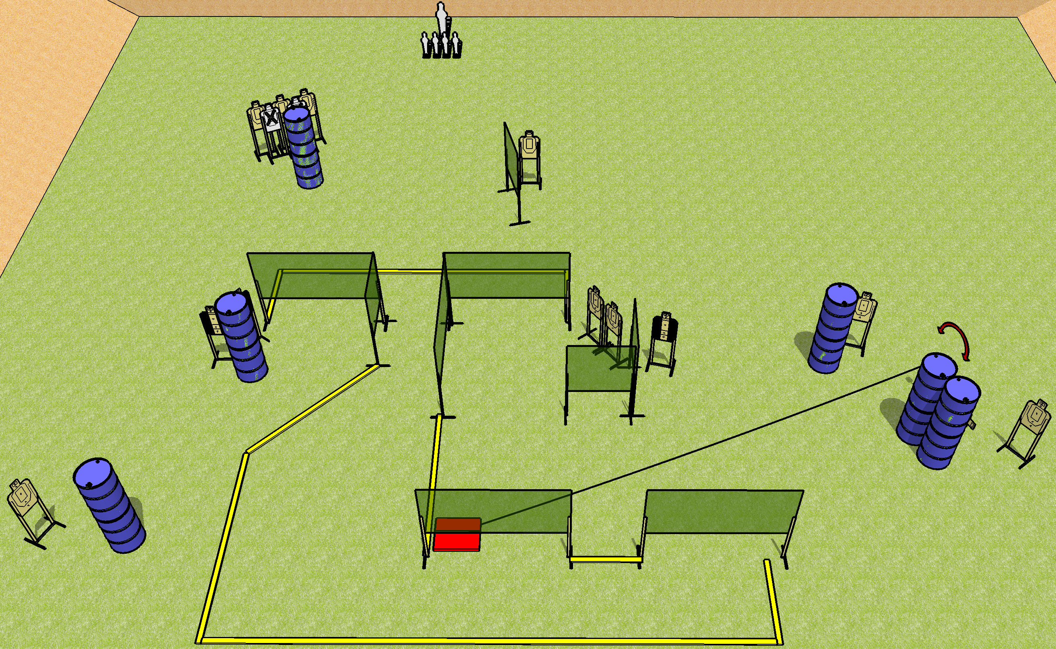
 | Dothan Gun Club – USPSA Match Step on the Box Course Designer : Drew Coleman
Round Count 31 rounds 13 USPSA 4 minis, 1 pepper popper
Equipment List 13 wall feet 4 medium fault lines Stomp box + activator 3 Tuxedos

Slide 12
Step on the Box
Written Stage Briefing
Step on the Box is a 31 round, 155 point, Comstock course of fire. There are 13 USPSA targets, 4 mini poppers, and 1 pepper popper. The best 2 hits on paper will score, and steel must fall to score. The start signal is audible.
The swinger is activated by the stomp box and is visible at rest. The stomp box is NOT part of the shooting area. Please check the activator prior to walkthrough and set it the same way every time.
Handgun start position is anywhere inside the shooting area, wrists below belt. Handgun is loaded and holstered.
PCC start position is anywhere inside the shooting area, stock on belt. Carbine is loaded, safety on.
On start signal, engage targets as they become available from within the shooting area.

